Slide 1
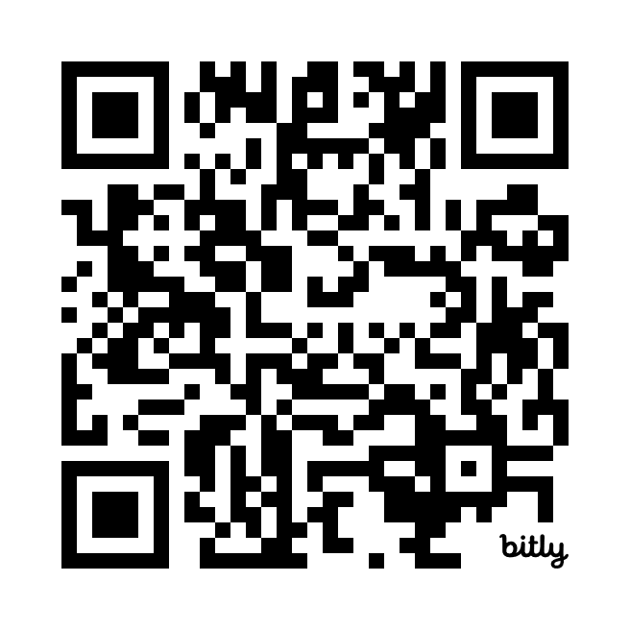
GitHub Copilot 2 Quiz
https://bit.ly/4fwFtxP

